Slide 1
Team Big Billion - Hack The Mountains 2.0
Our team members:
Shashank Kumar , Prashant Kushwaha , Harsh Raj and Priyansu Pritam Sahoo

Slide 2
Changing convention with Ethereum
Ethereum is the largest decentralized software platform that allows you to build smart contracts and decentralized applications without any downtime and without any third party interference.
It forms a decentralized and Peer-to-Peer network where all the applications run on a public ledger called blockchain.
Blockchain also provides transparency to the users and prevents the network from various fraudulent attempts and hackers looming around the internet

Slide 3
What Is A Blockchain?
A blockchain public ledger that keeps a shared record of all the transactions distributed over a vast network of users.
It is truly decentralized network and doesn’t require any intermediate system for the exchange of services.
A blockchain is comprised of a series of data blocks wherein each block stores a small patch of transactions made by the users.

Slide 4
Advantages of Ethereum
Ethereum is a big and innovative community all around the world that gives people ease of international payments.
It provides customer almost 0% transaction fees and the most important thing that make it attractive is that it’s a decentralized platform.
Sellers don’t have to install any 3rd party application and gives them the freedom to do instant secure payment.

Slide 5
Crypto-KART
Crypto-KART is a decentralized system for customers who wants to buy some products such as Phones, from the following store with beneficial of using Ethereum technology.
Due to which both consumer and seller get advantages of Ethereum payment portal hence it runs without any downtime, fraud, control or interference from a third party.
The consumer can also easily locates the nearest local stores with there products and services and also can proceed to online transaction through Ethereum.

Slide 6
Technologies we used for Development
HTML (Website formation)
CSS (Website formation)
Bootstrap (Website formation)
Node.js (Website deployment)
GitHub (Website deployment)
MetaMask (Secure Ethereum wallet)
Ganache (Virtual Ethereum Transaction Passbook)

Slide 7
Challenges we ran into:
We successfully created the website with the help of HTML, CSS and Bootstrap but we haven’t tried the deployment work till date. We luckily got a free course on Udemy through which we acquired the knowledge of website deployment. So, it took hours for us to do the deployment of code through Node.js and also on GitHub.
We also used API for real time conversion of Rupees and Ethereum which was also a new task for us. We learnt this from YouTube multiple videos and were able to connect the API.

Slide 8
Challenges we ran into:
Making a MetaMask wallet and using Ganache was also challenging as took time for us to understand the whole process of transaction. For this, we watched tutorial videos from YouTube that really helped us a lot.
At last, we connected all the application on the same node which was challenging and took hours of hard work to complete the project as one. For this also we watched YouTube videos and installed Node.js successfully for deployment.

Slide 9
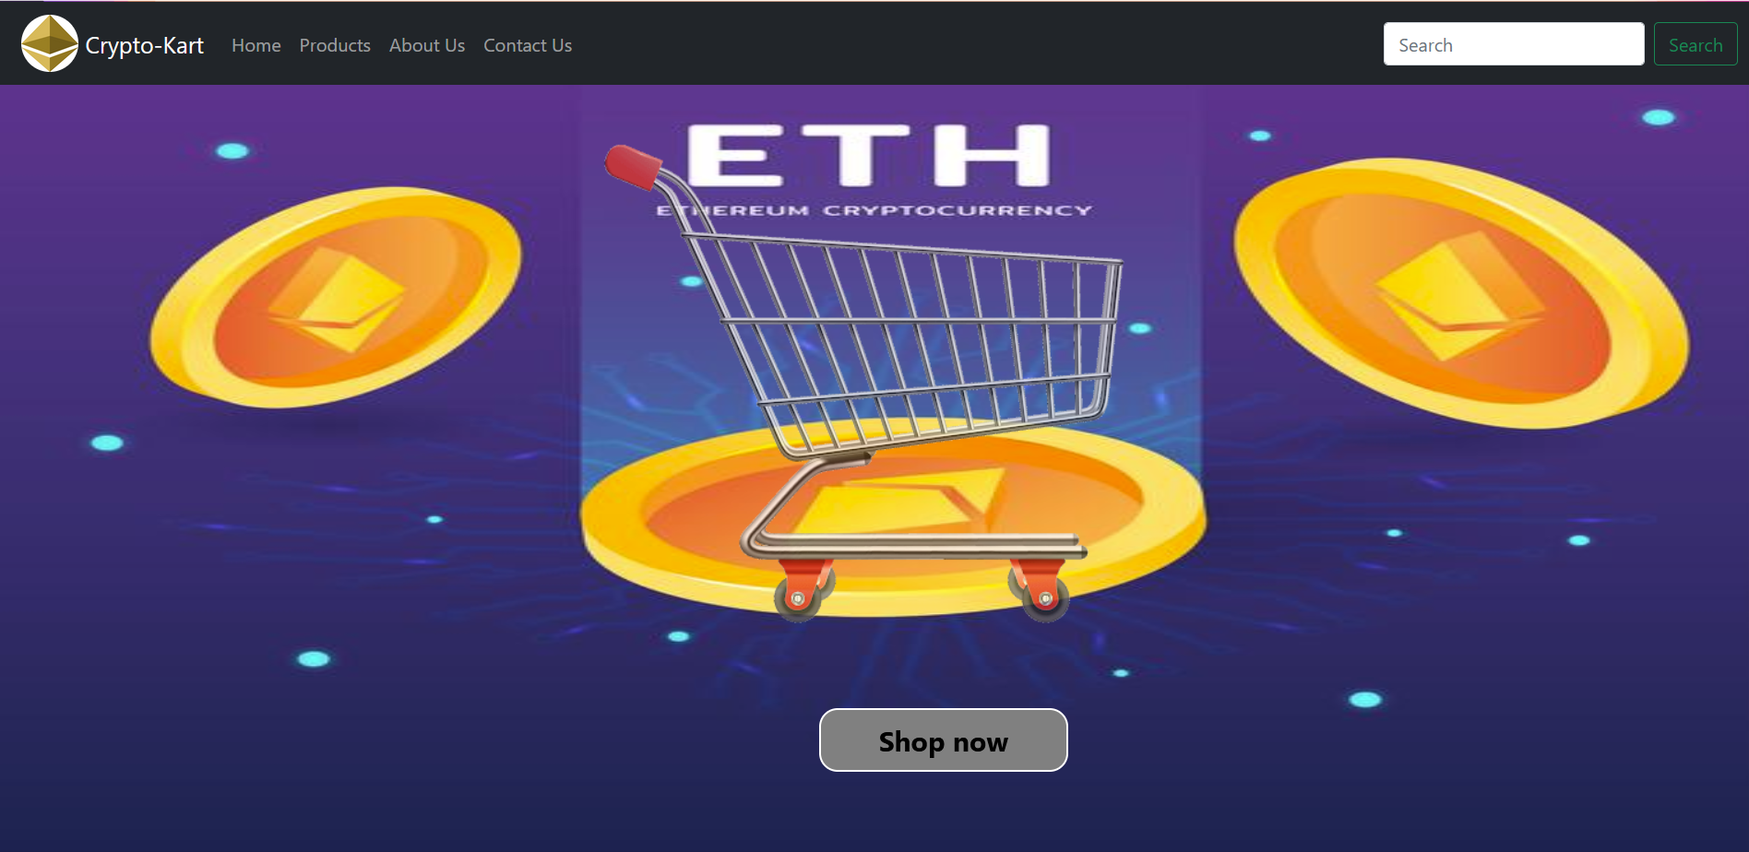
Web-view of our website

Slide 10

Web-view of our website

Slide 11
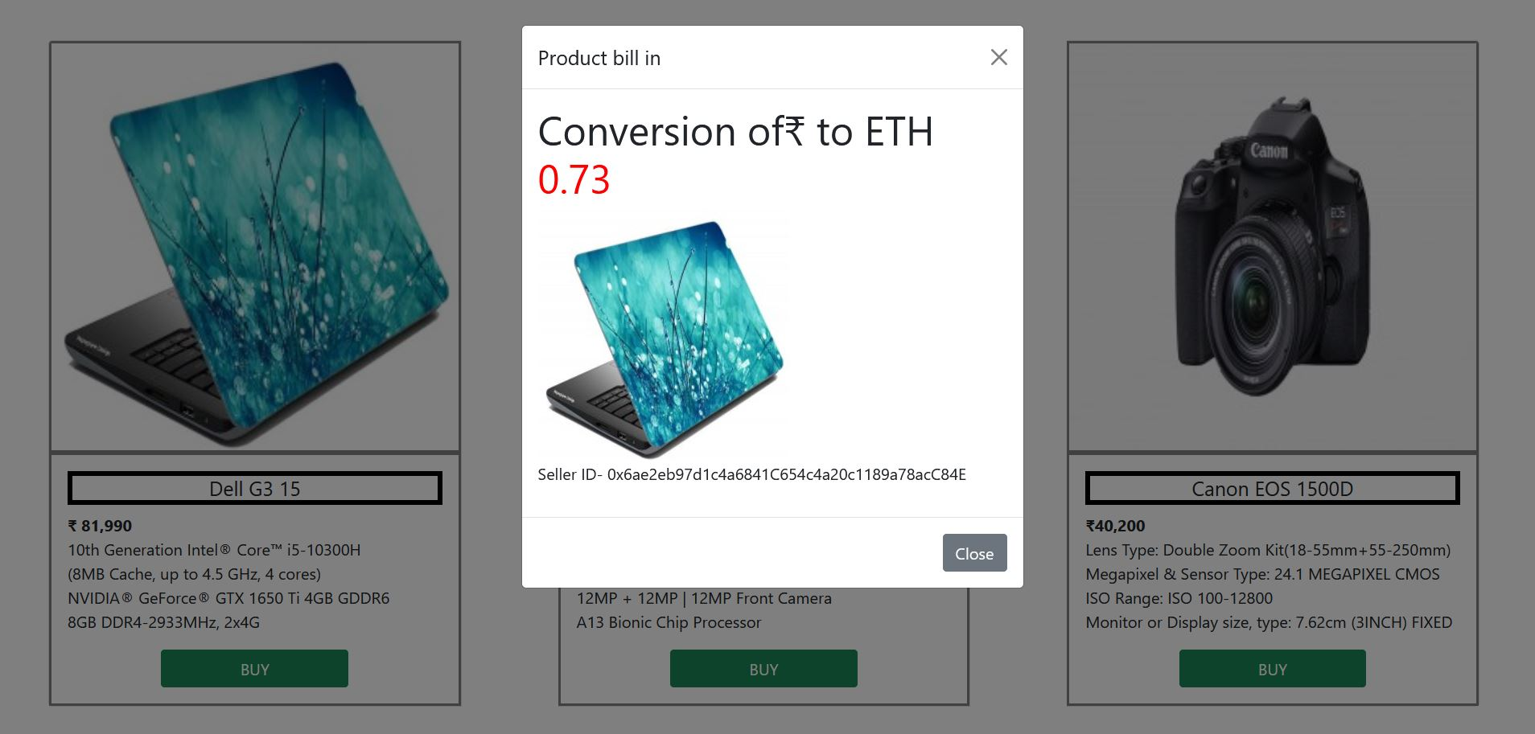
Web-view of website

Slide 12


